Slide 1

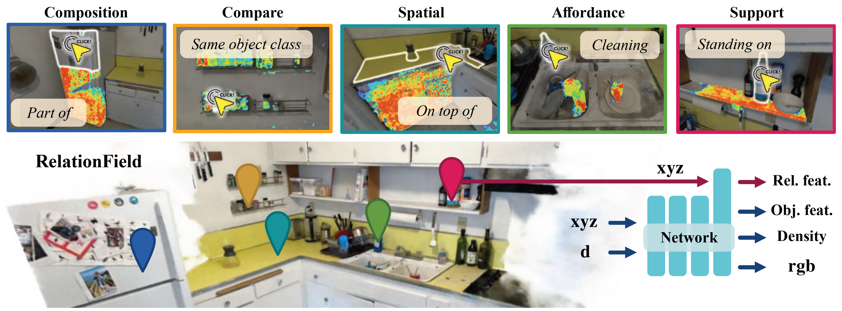






RelationField
Relate Anything in Radiance Fields
CVPR 2025
Sebastian Koch Johanna Wald Narunas Vaskevicius Mirco Colosi Pedro Hermosilla Federico Tombari Timo Ropinski
Notes:
In this video we will present RelationField: Relate Anything in Radiance Fields.

Slide 2
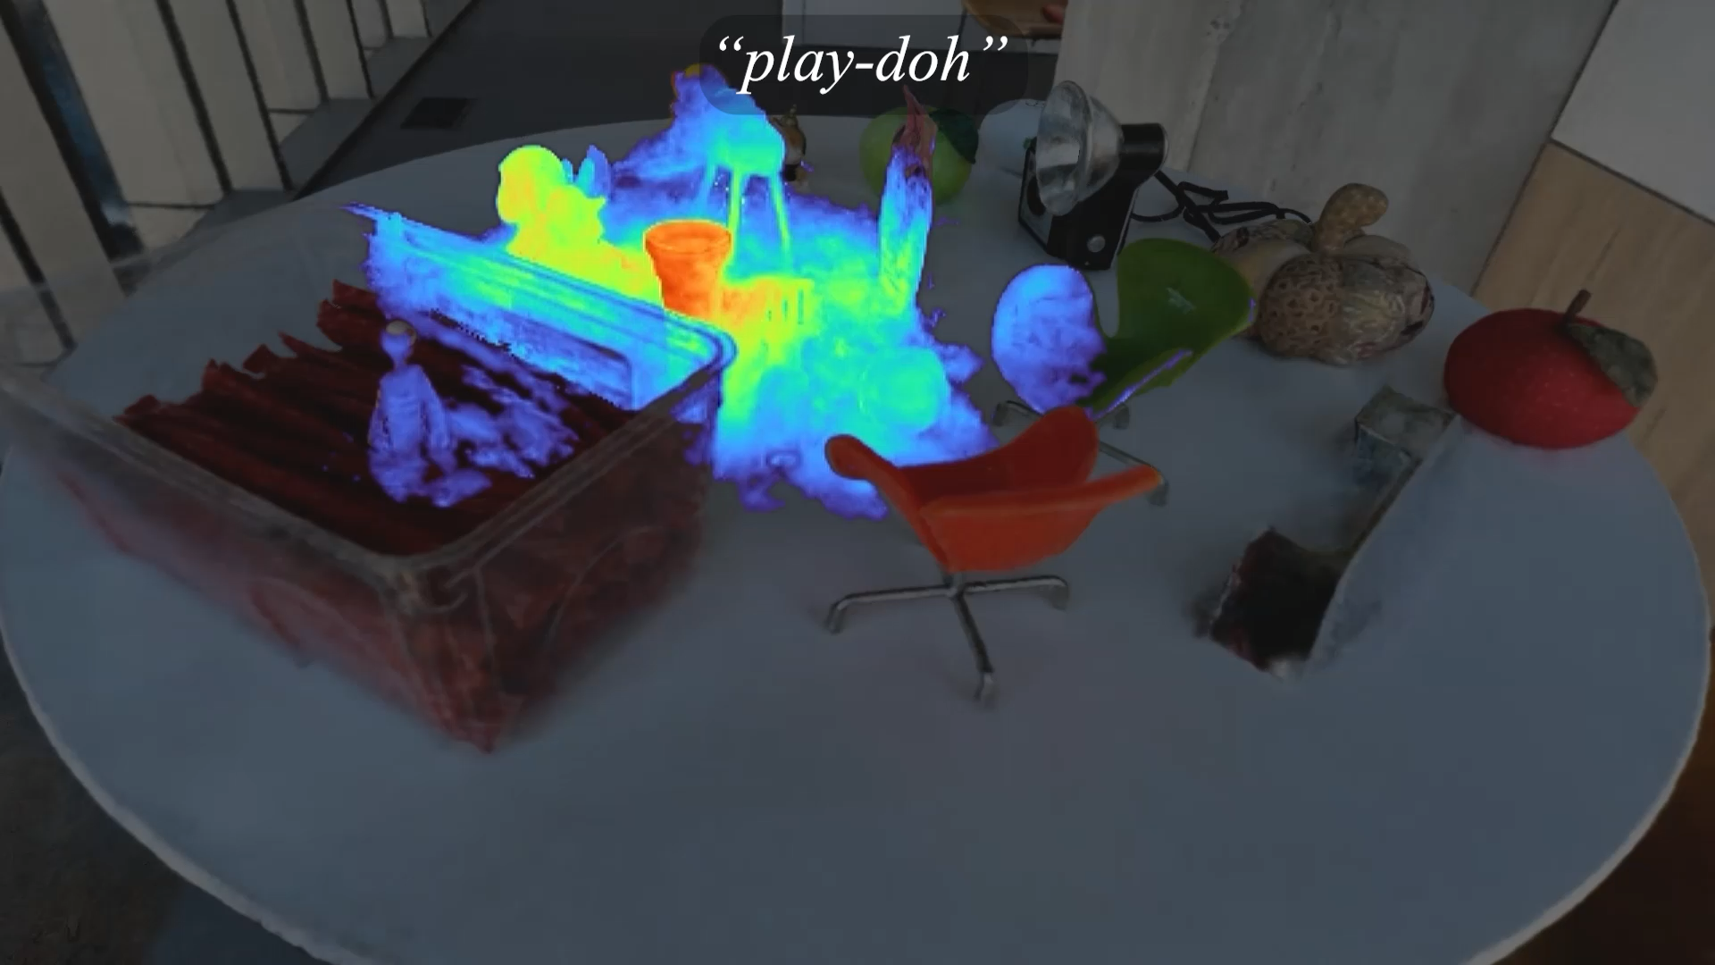
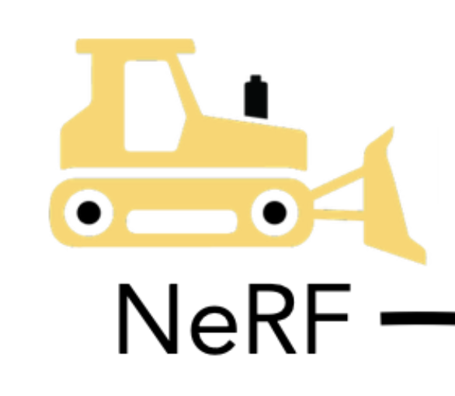



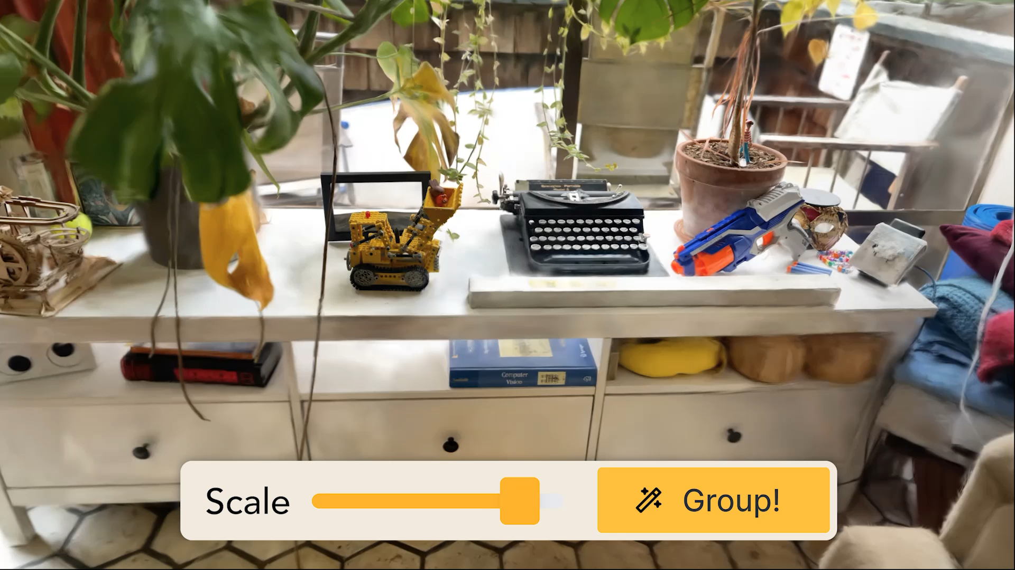
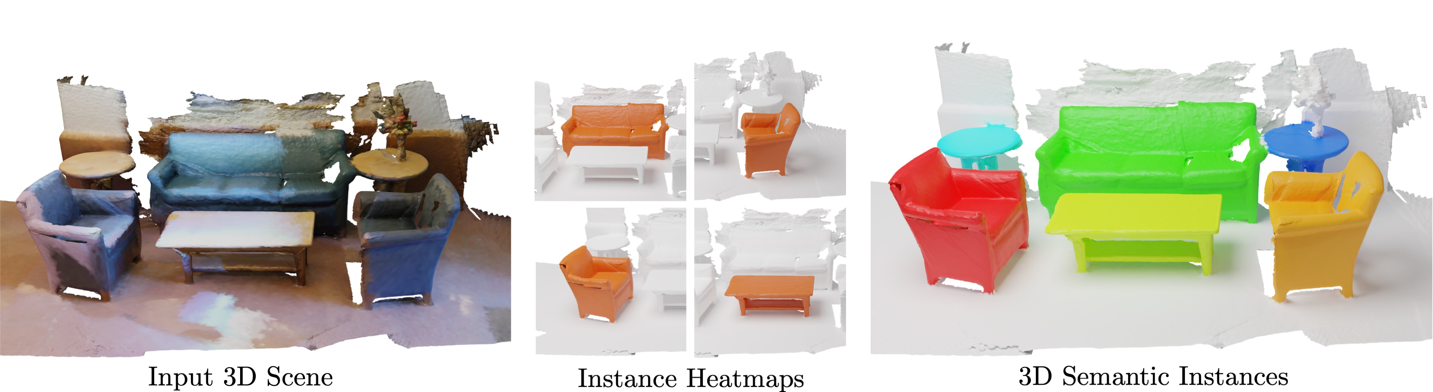
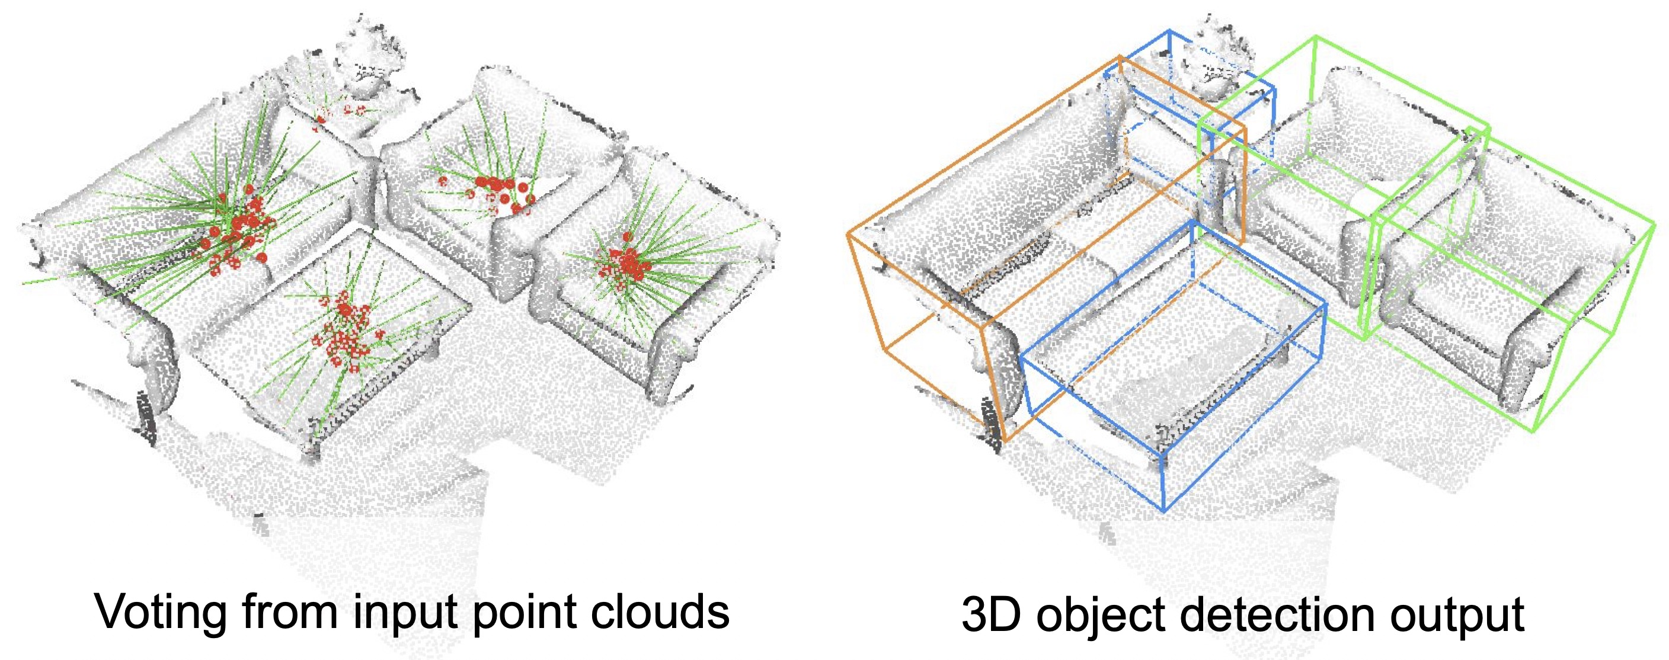
Radiance Fields & Feature Fields
☹️ Existing feature field approaches focus on object-centric representations
LERF (Open-Vocabulary Object Localization)
+
=
DINO
CLIP
Stable Diffusion
Feature Fields
GARField (Interactive Instance Segmentation)
🙂 Interactive object semantics with open-vocabularies
🙂 Integrate 2D foundation models into 3D seamlessly
☹️ Works only with simple, object-centric queries
☹️ Relationships and object interactions are ignored!
[1] Kerr et al.: LERF: Language Embedded Radiance Fields, ICCV’2023 [2] Kim et al.: GARField: Group Anything with Radiance Fields, CVPR’2024
3D Semantic Instance Segmentation
3D Object Detection
Notes:
In recent years, radiance field approaches such as NeRF or Gaussian Splatting have been combined with 2D foundation modeles such as DINO, CLIP, SAM or Stable Diffusion to form so called "Feature Fields".
These feature fields can be used to perform tasks such as Open-Vocabulary Object Localisation or Interactive Instance Segmentation.
While NeRF was originally proposed for novel-view synthesis, it is ideal to lift 2d foundation model knowledge to 3D, as NeRF directly models the underlying 3D geometry, but is exclusievly supervised by 2d images which can be used to extract foundation model features.
However, existing works mainly focus on object centric representations and completely ignore relationships and object interactions

Slide 3
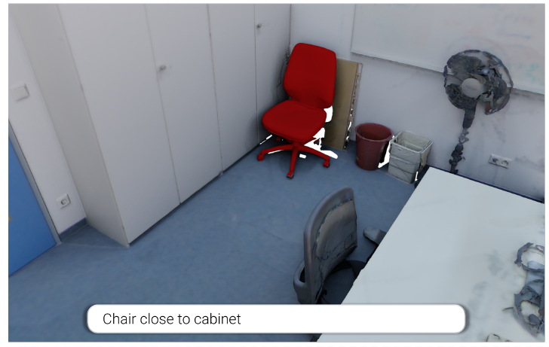
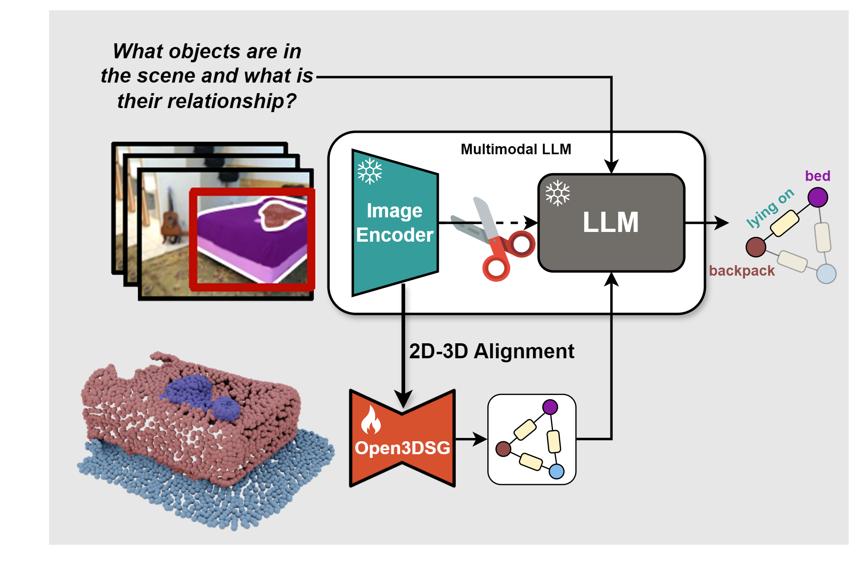
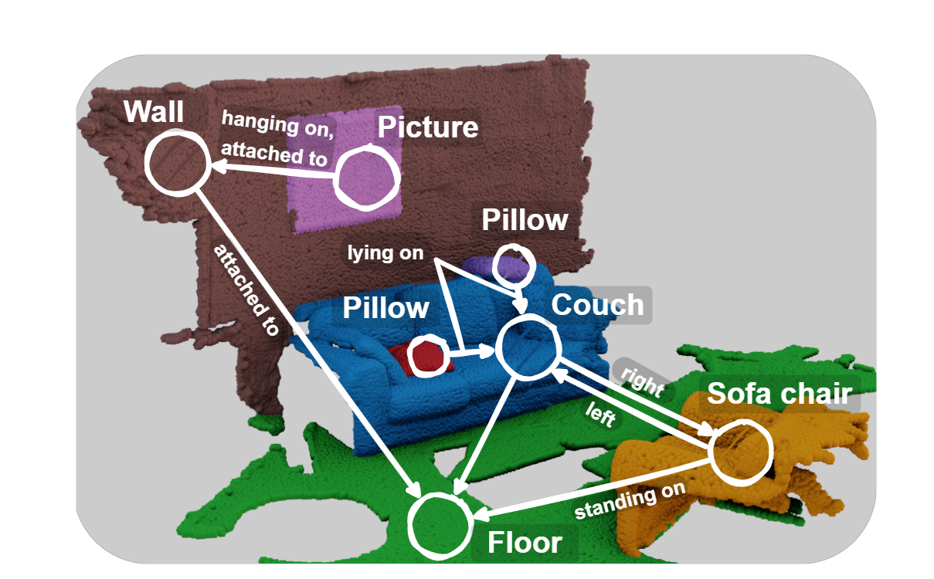



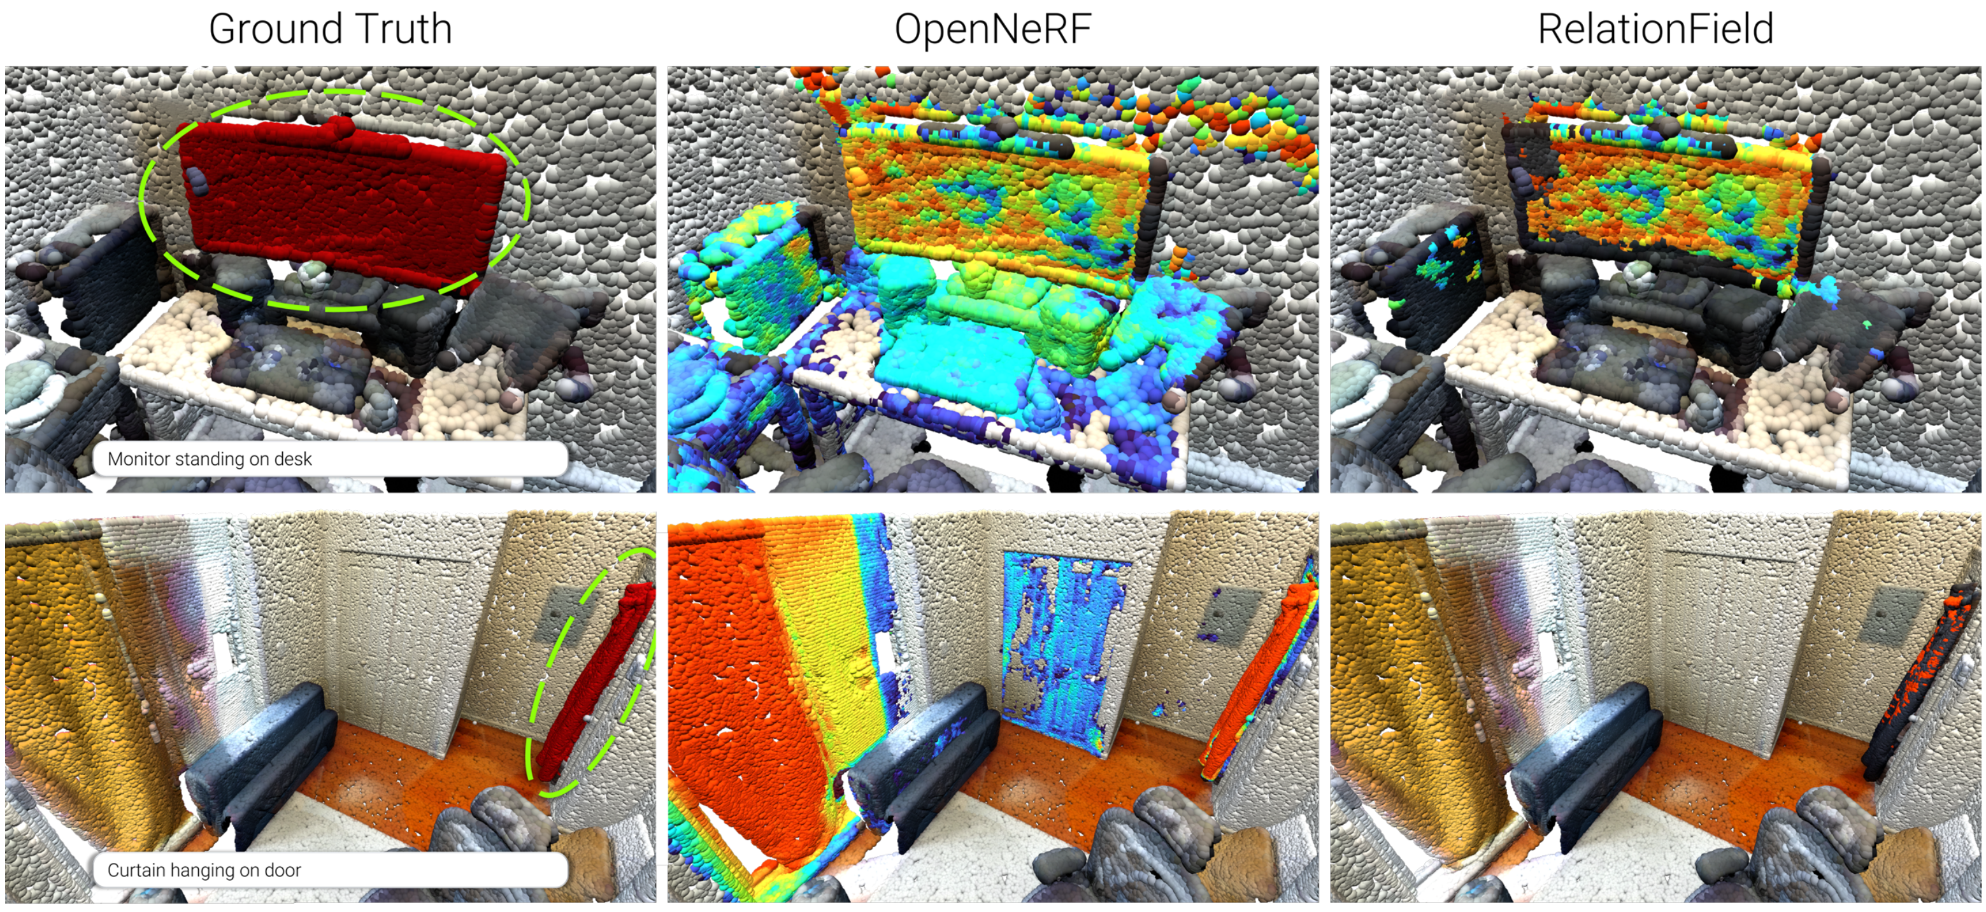
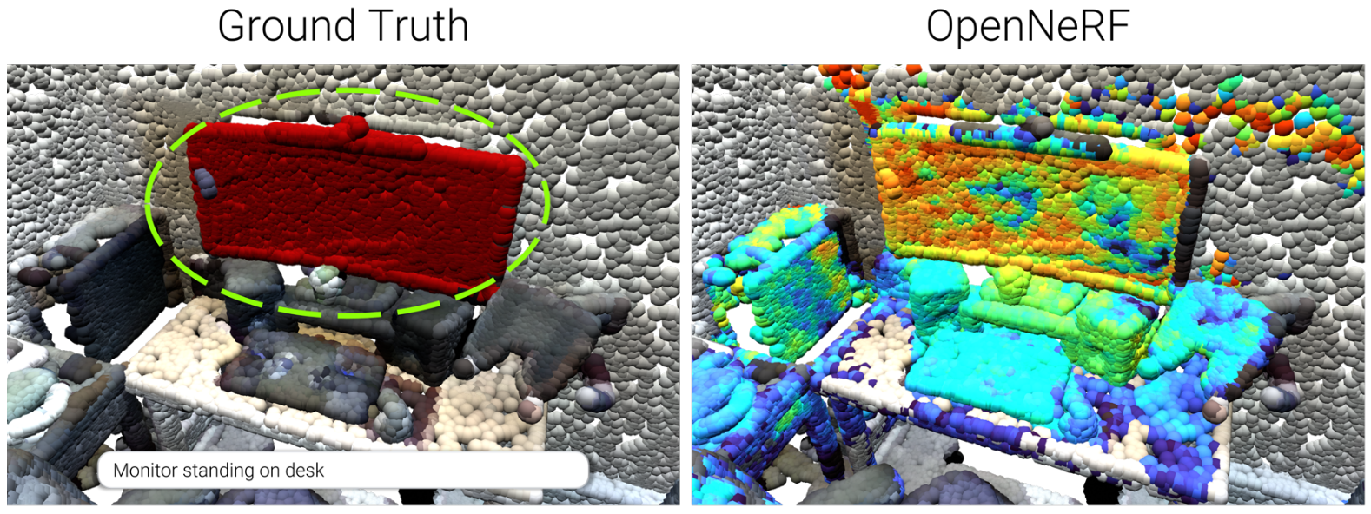
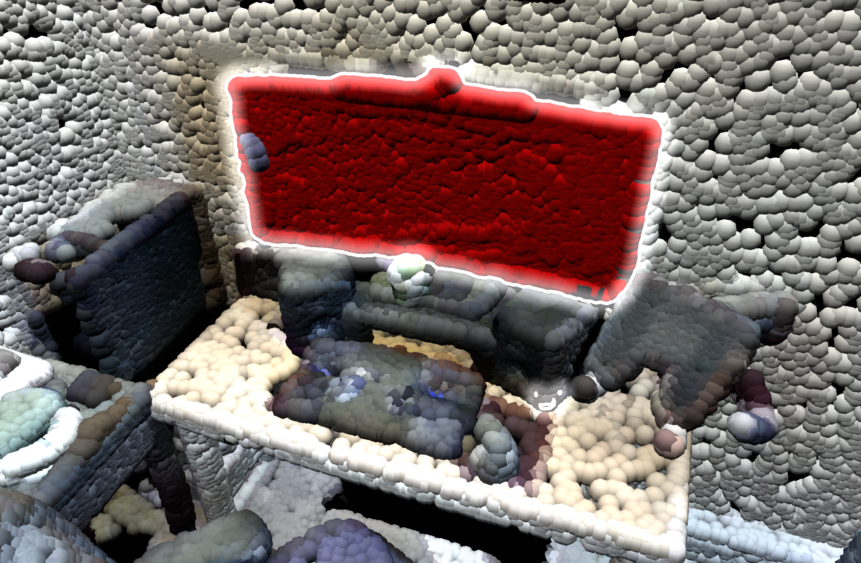
Why do relationships matter?
Open3DSG (Open-Vocabulary 3D Scene Graphs)
Bring me the chair close to the cabinet
🙂 Open-Vocabulary Objects & Relationships
☹️ Requires point-clouds, expensive training & - static (non-interactive) inference
🙂 3D Scene Graphs can model complex scene elements
Objects
Relationships
Affordances
Attributes
Etc.
🤔 Goal: Integrate Object & Relationship understanding in radiance fields
[1] Koch et al.: Open3DSG: Open-Vocabulary 3D Scene Graph Prediction from Point Clouds with Queryable Objects and Open-Set Relationships, CVPR’2024
Bring me the chair close to the cabinet
Monitor standing on the desk
Notes:
But why does understanding relationships matter for 3D scene understanding.
I argue that it is very important.
Lets look at the is simplified example where a human tasks his robot assistant to fetch the chair close to the cabinet.
Notice that there are two chairs in the scene. One close to table which is probably needed by a friend or collegue and one near the cabinet.
We of course want to free chair and therefore it is important that our method can differentiate between these two.
3D scene graphs have been proposed to solve this problem, by encoding objects and their relationships in a graph structure.
However they require reconstructed point clouds, are expensive to train and do not offer this interactive quering seen in the feature fields before.
Therefore our goal is to propose a feature field that encodes objects & their relationships similar to a 3d scene graph but is only learned from 2d images and is similarly interactive as methods such as LERF.

Slide 4
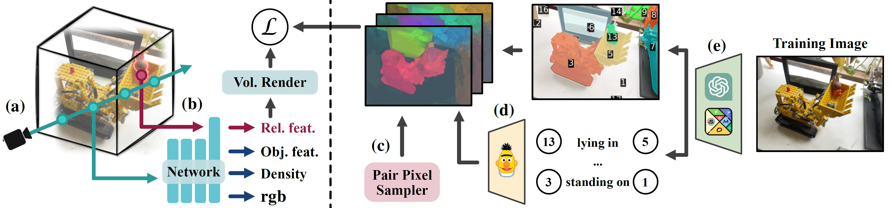
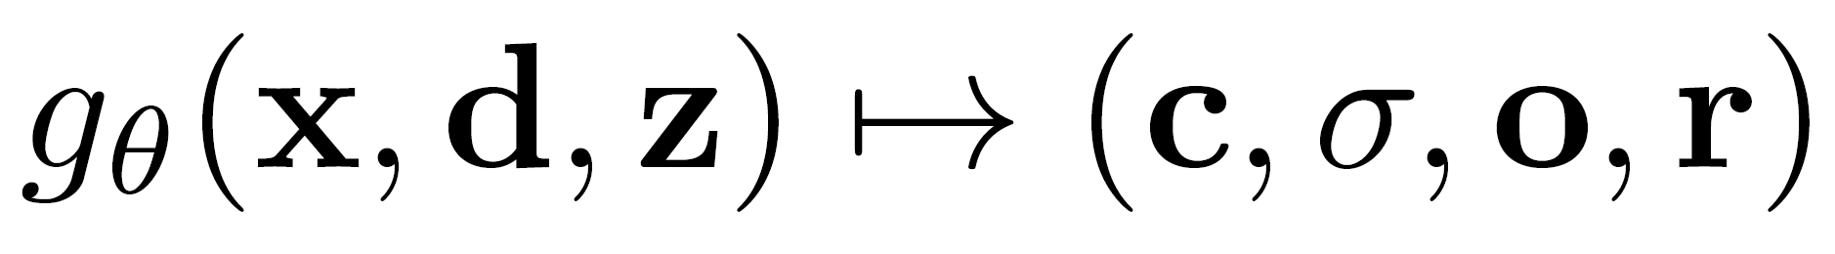
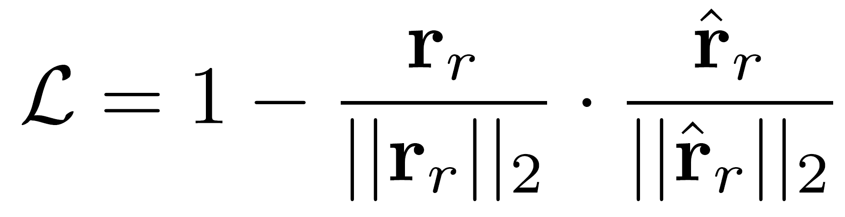
RelationField Training
Radiance field equation:
Loss function:
BERT embedding for feature supervision and concept generalization
GPT-4o + SoM for mask-aligned relationship captions
50 – 200 training images per scene
Notes:
To train RelationField, we follow the general NeRF practice, we shoot a ray into 3d space from our camera, but now with an additional xyz for the relationship query.
The neural network then outputs rgb, density, obj feat, rel feat for the given ray and we render this to the image plane for supervision.
For supervision we need between 50 to 200 images given the size and complexity of the scene.
We then encode each image with a foundation model, here chatgpt together with an advanced visual prompting strategy, which overlays autogenerated masks on top of the image together with these numbered tags, such that it is easier for models such as chatgpt to reference objects and their relationships.
The output of chatgpt are textual captions of the relationships together with the tags for the objects. But we cannot use the captions directly, we need to encode them to a high dimension space, with a language encoder such as bert and place them in the referenced masks.
Each image then generates multiple of these relationship feature maps, as each encodes a single relationship between objects. Then we use a pair pixel sampler, to efficiently select pixel pairs, that contain embeddings of object relationships for supervising the ray output coming from our NeRF.
The training loss is a simple cosine similarity loss for feature distillation.

